Slide 1
The impact of walkable cities in Texas on the mental health of its residents
By: Malawika Gopinath, Raquel Luna, Richa Gandhi, and Bheshta Shahim

Slide 2

Area of Study
Metropolitan cities in Texas
Dallas - Fort Worth
Austin
Houston
Notes:
With this study, we aim to primarily focus on metropolitan areas in Texas and compare the walkability indexes of different major cities in the state. We also want to examine the counties within the Dallas-Fort Worth (DFW) area. As one of the largest and most rapidly growing metropolitan regions in the U.S., DFW provides a unique opportunity to investigate the relationship between walkability and health outcomes across diverse environments. We can analyze these patterns and trends to find correlations between walkability and the physical and mental health of residents. With these findings, we can provide insights into how urban design and infrastructure in Dallas and other cities can be optimized.

Slide 3

Research Question
Do walkable cities improve mental health outcomes for residents?
Impact of urban walkability on mental health outcomes.
Focusing on depression
Why is this important?
Gaps in the literature – few studies focusing on depression and walkability in Texas
Preventative measure for mental health illness
A future where city design can improve mental health.

Slide 4

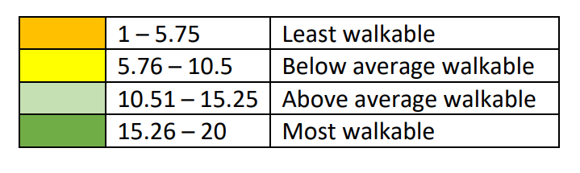
Measures
Independent: Walkability Index (EPA)
Gives a quantifiable score for the walkability of a “block” which is smaller than a census block.
Represents the parts of urban design that may influence mental health outcomes.
Dependent: Depression (CDC)
Provides insight in mental well-being of residents.
Helps us understand the mental health impacts of urban planning.

Slide 5
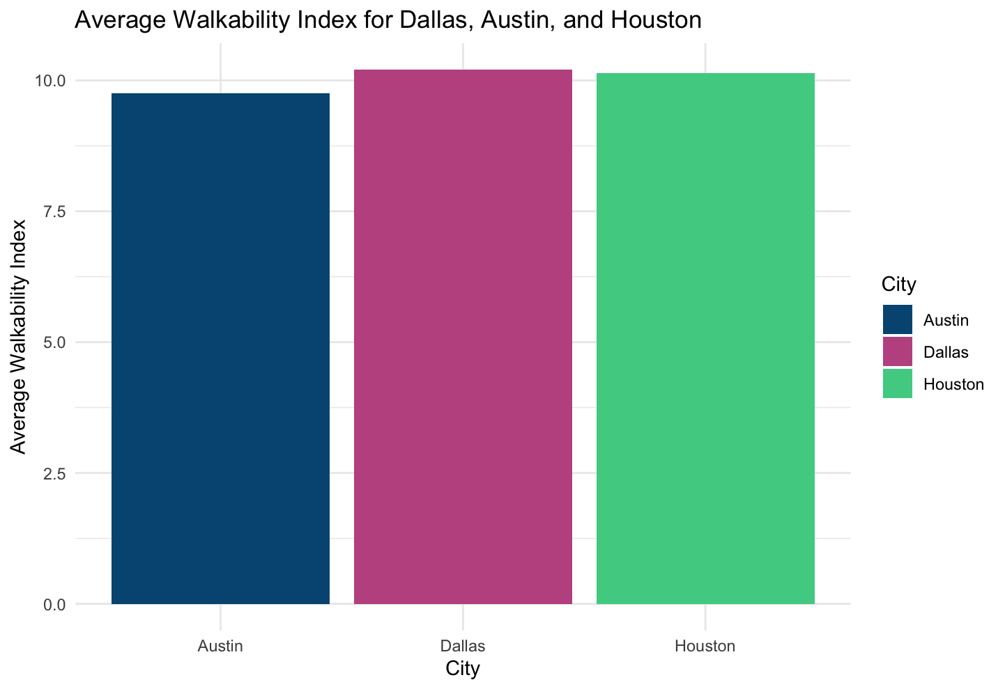
Austin, Dallas, and Houston Average Walkability Score
Notes:
Scores for all cities are below-average per the Walkability Index.

Slide 6
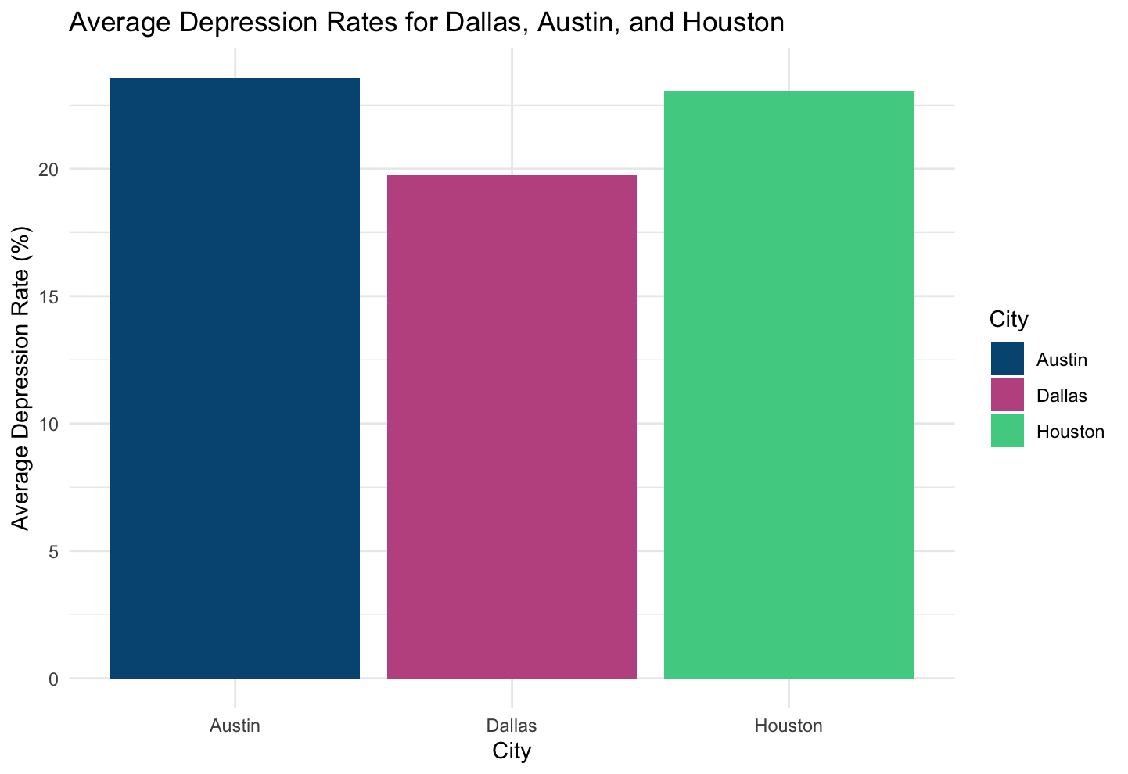
Austin, Dallas, and Houston Average Depression Rates

Slide 7
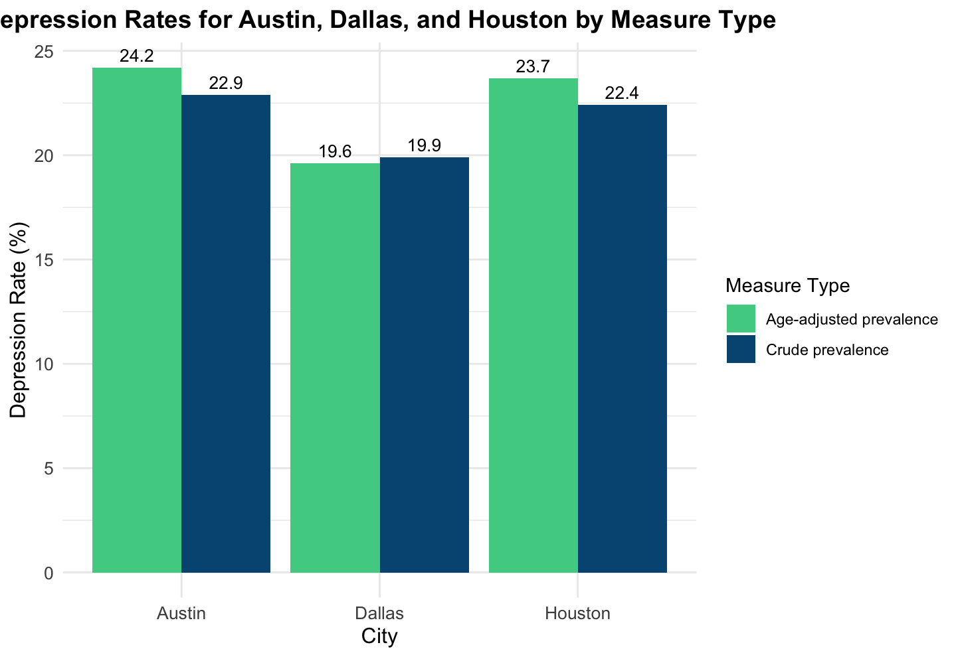
Austin, Dallas, and Houston Depression Rates by Measure Type

Slide 8
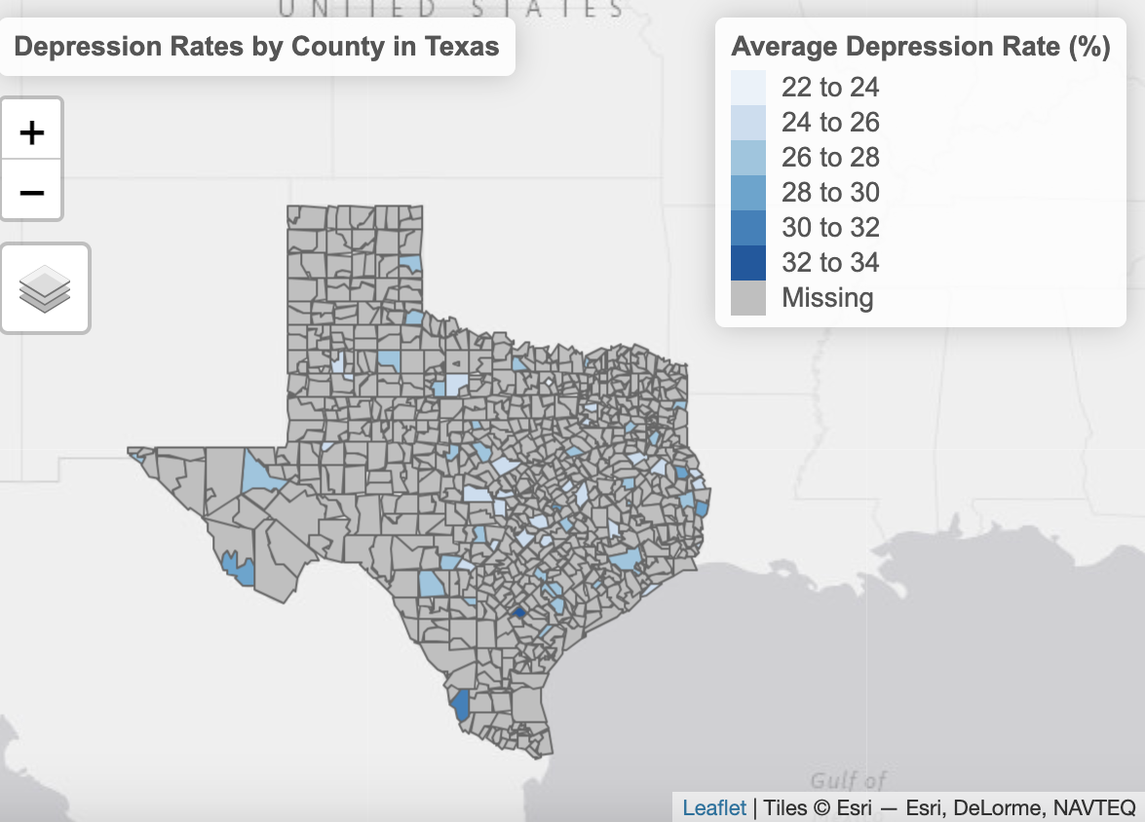
Average Depression Rate (%) by County in Texas
Notes:
Austin: 26% - 28%
Dallas: 28% to 30%
Houston: 28% to 30%

Slide 9
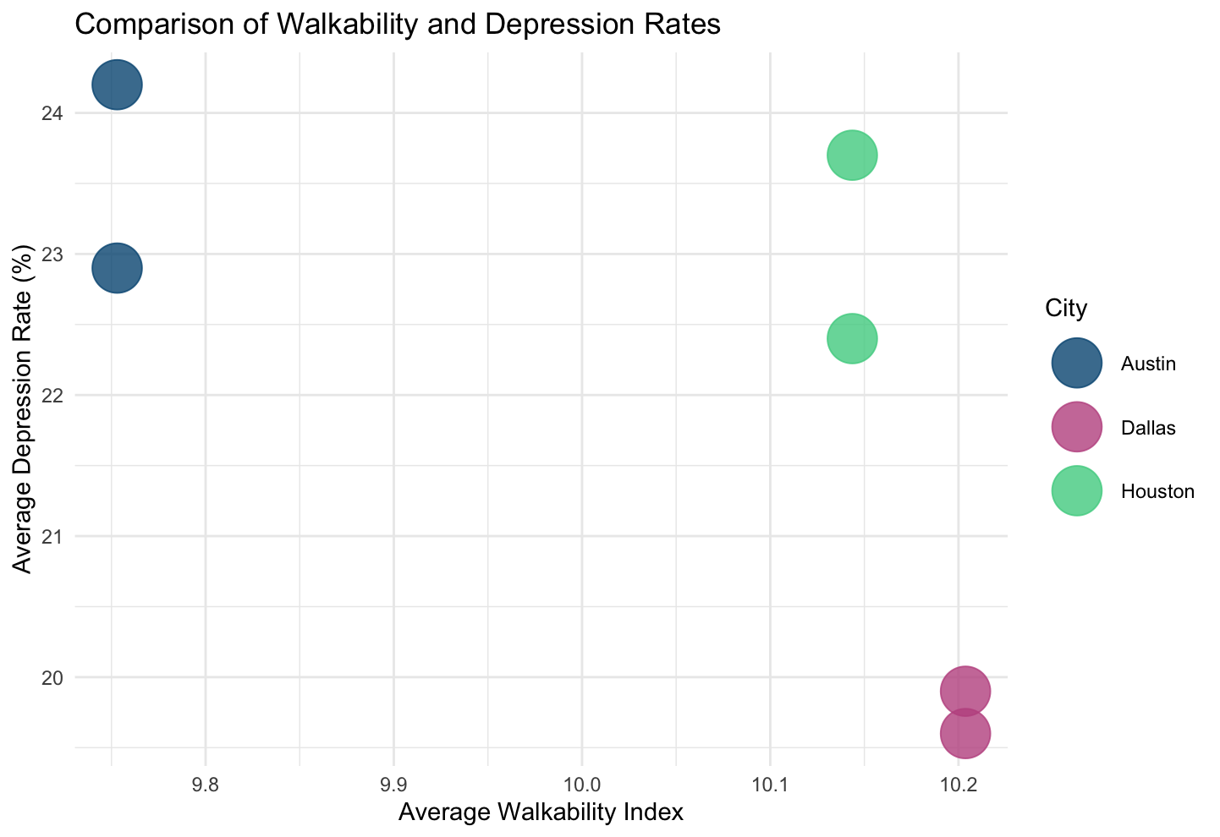
Scatter Plot of Average Depression Rates and Average Walkability Index

Slide 10
Findings/Summary & Limitations
Variables
Walkability - National Walkability Index (X- Independent)
Mental Health Outcomes - Depression (Y-dependent)
Mental Health Data
Raw data was inaccessible, hard to find
Other factors that affect mental health (income levels/social and economic factors)
Walkability
Difficult to measure walkability (Ex: population and intersection density and public transit access)
We aren’t able to draw conclusions on the strength or extent of the relationship
Higher walkability index correlates with lower average depression rates, but causation cannot be established
Illustrates the need for more nuanced/detailed research

Slide 11
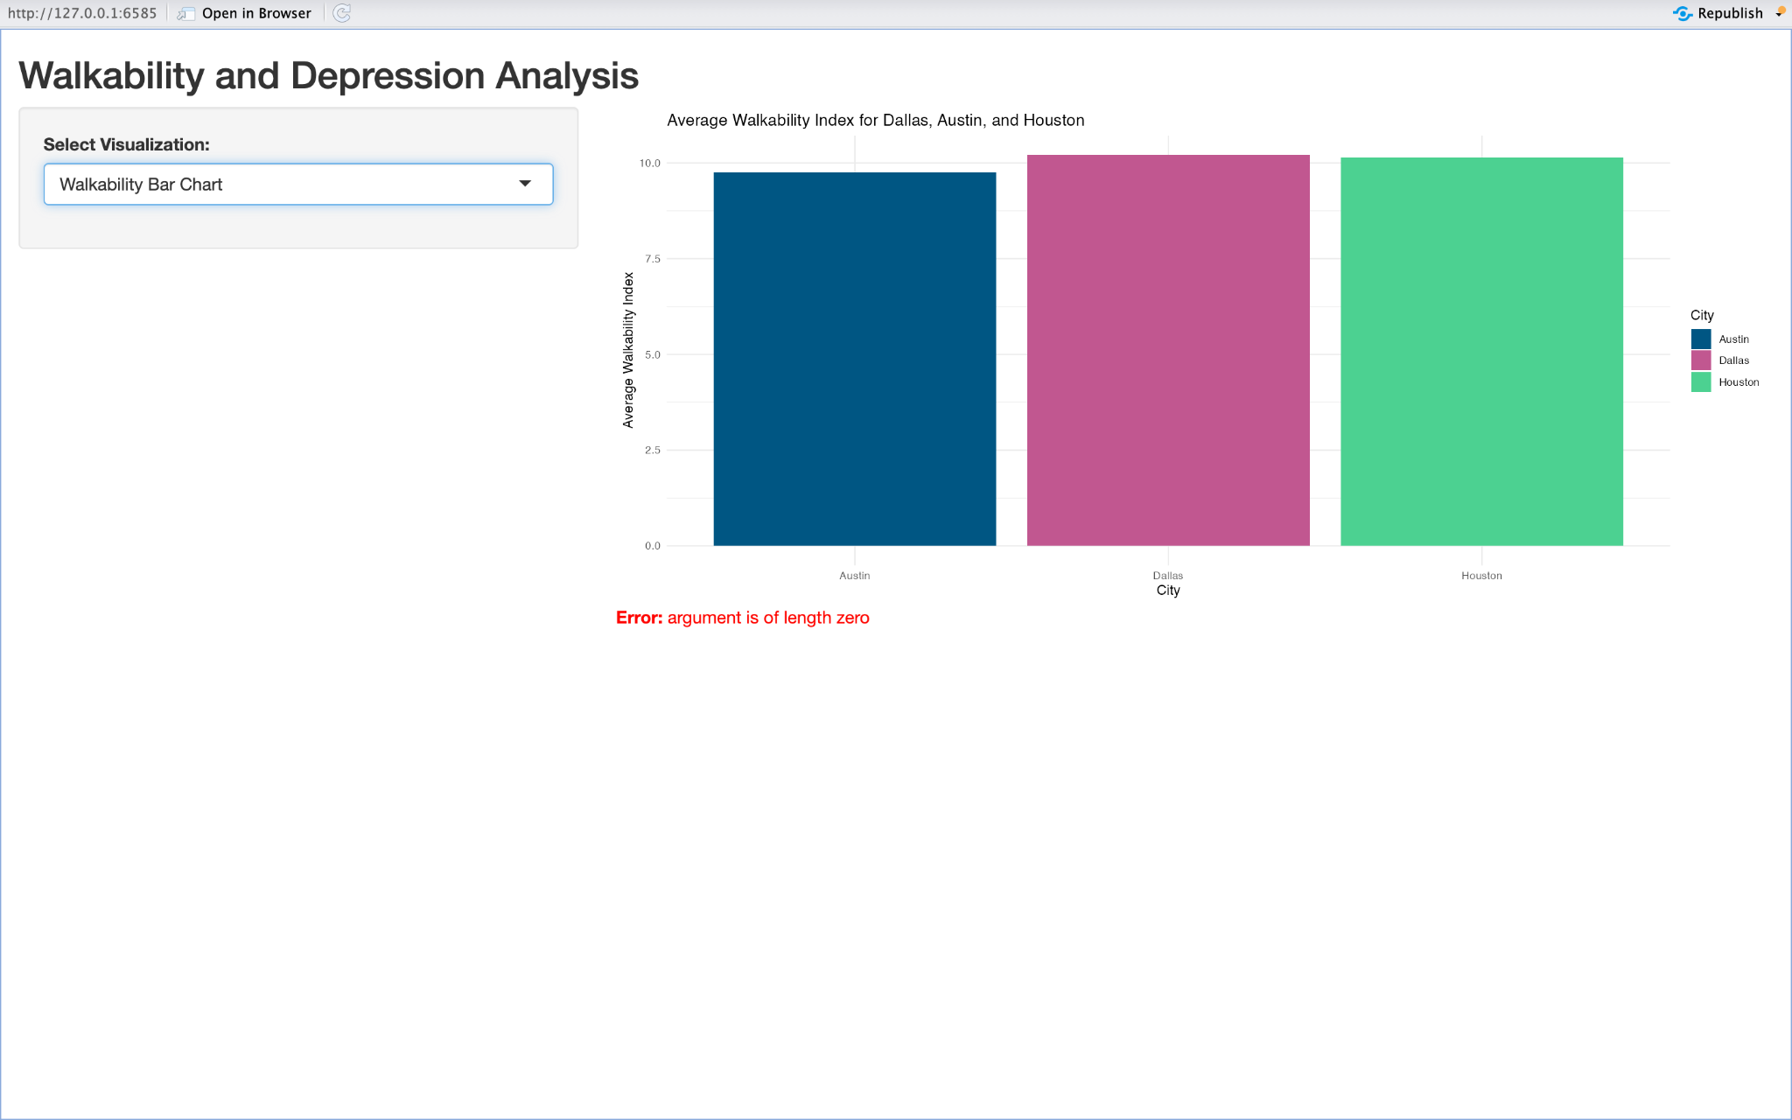

Slide 12
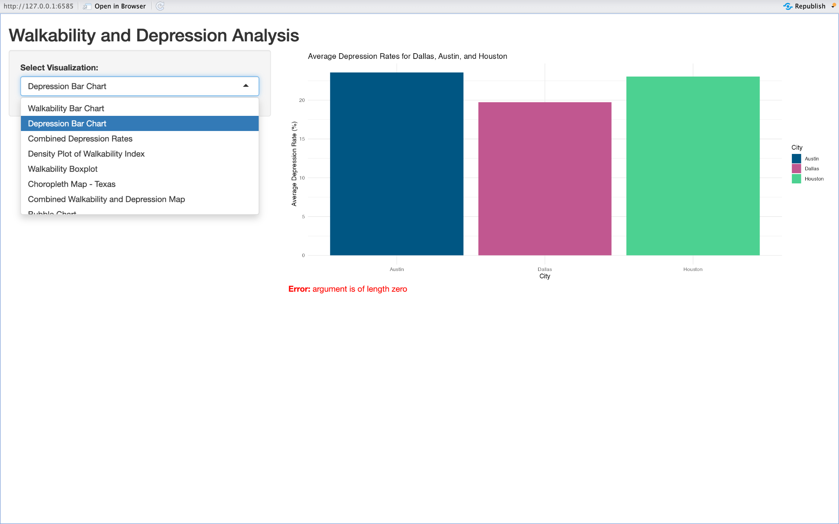

Slide 13
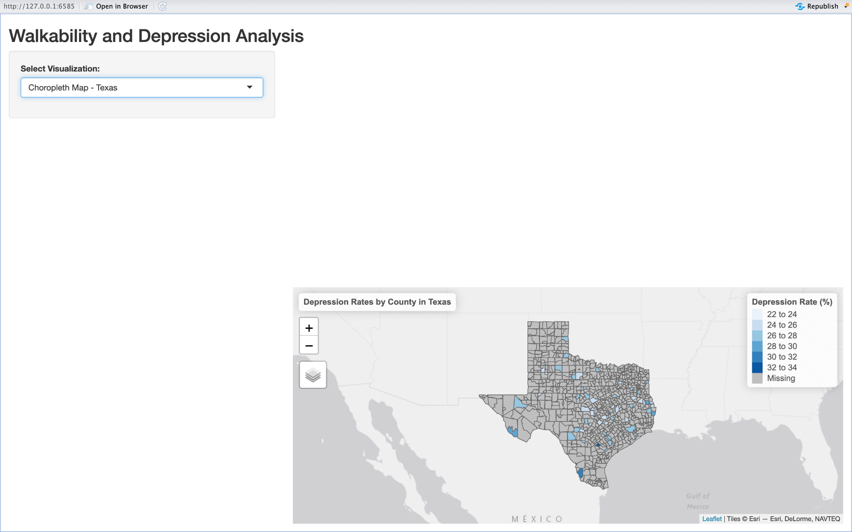

Slide 14
